Slide 1
Impacts of AI on Education
Exploring how artificial intelligence is transforming learning

Slide 2
Introduction to AI in Education
1. AI refers to the simulation of human intelligence processes by machines, especially computer systems.
2. AI in education involves the use of algorithms and software to facilitate learning processes and outcomes.
3. The adoption of AI tools is rapidly growing across educational institutions worldwide.

Slide 3

Personalized Learning Environments
1. AI enables personalized learning experiences tailored to individual student needs.
2. Adaptive learning technologies adjust content based on student performance and learning pace.

Slide 4
Enhancing Administrative Efficiency
1. AI automates administrative tasks such as grading, scheduling, and student assessments.
2. This automation frees up valuable time for educators to focus on teaching and student engagement.
3. AI-powered analytics provide insights into student progress and institutional performance.

Slide 5
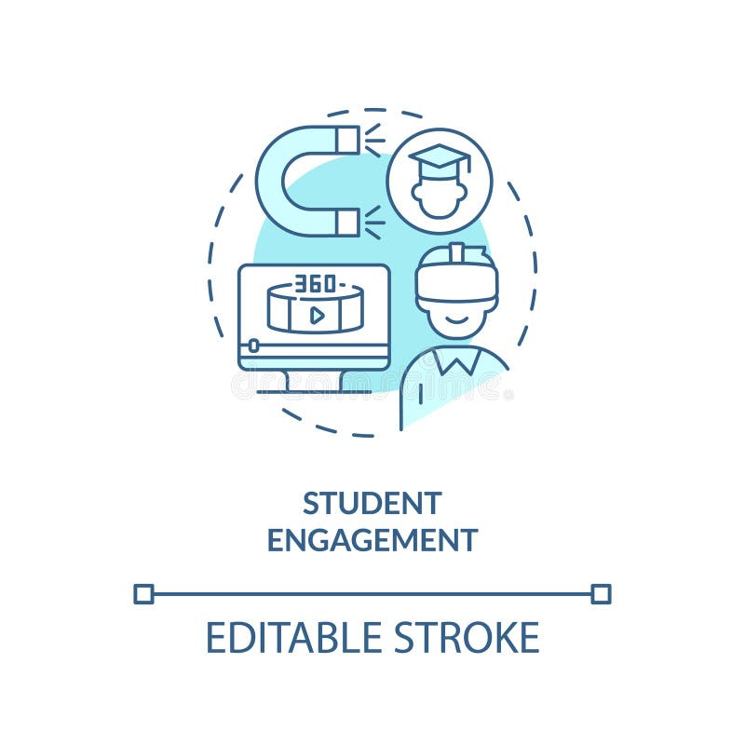
AI and Student Engagement
1. Interactive AI tools such as chatbots and virtual tutors increase student engagement.
2. These technologies provide instant feedback and support outside traditional classroom settings.

Slide 6
Challenges and Considerations
1. Privacy and data security concerns arise with the use of AI in handling student data.
2. There is a risk of bias in AI algorithms that could impact fairness and equality in education.
3. Adequate training and adaptation are necessary for educators to effectively implement AI.

Slide 7
Thank You

